Slide 1

Weiss High School
March 5 2019

Slide 2

About Me
Shawn Weisfeld
Cloud Solution Architect
Microsoft – One Commercial Partner Technical Team
sweisfel@microsoft.com
https://www.linkedin.com/in/shawnweisfeld/
Austin, TX
Download Slides @ https://aka.ms/WHS/20190305

Slide 3
My Journey

Slide 4

Why is this important to you?
Source: https://thecoachingeducator.files.wordpress.com/2013/03/lost_confused_sign_mega.jpeg

Slide 5

Source: http://imgkid.com/snake-game-gif.shtml

Slide 6
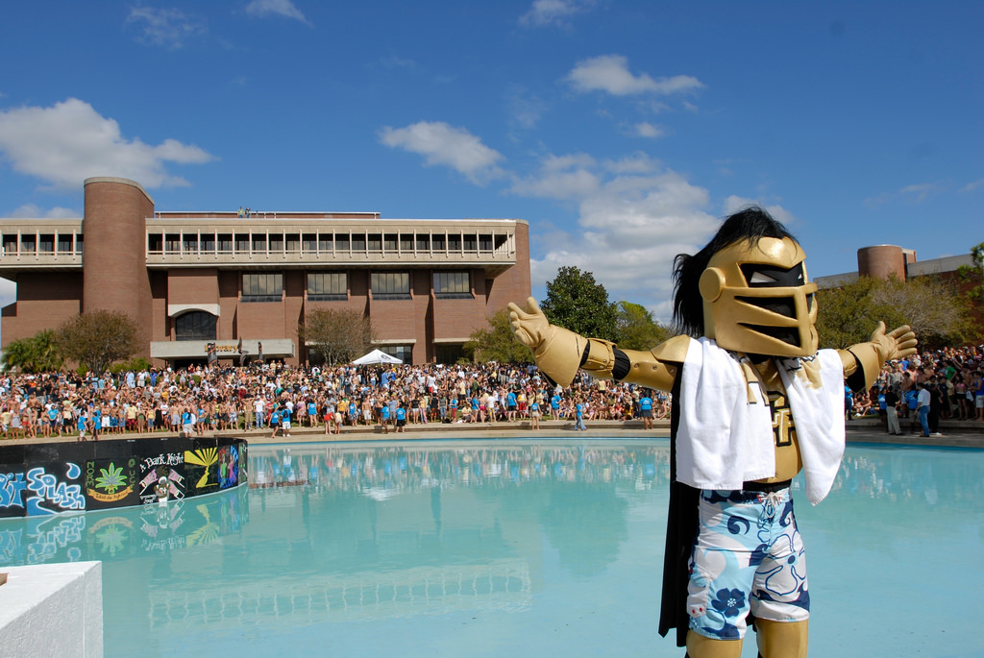

Source: https://www.flickr.com/photos/universityofcentralflorida/3402843642

Slide 7

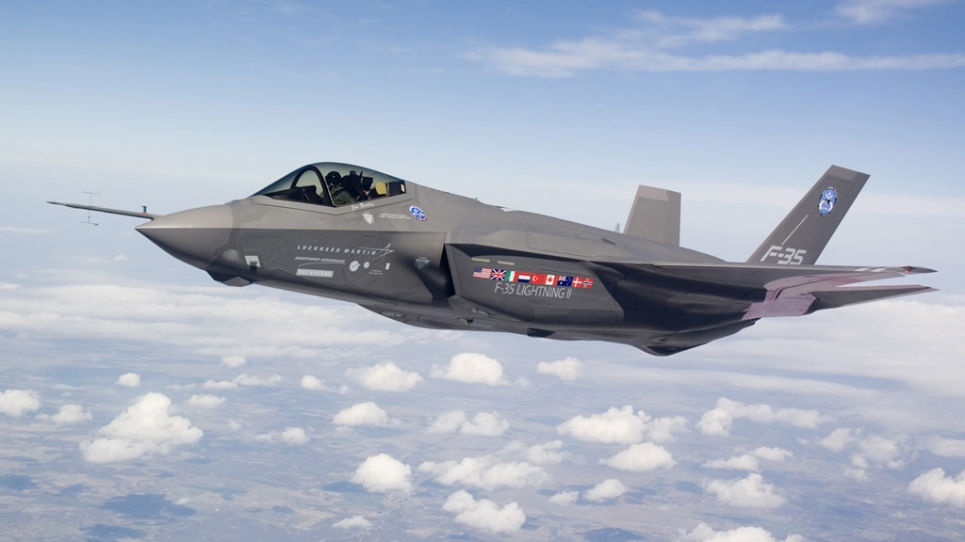
Source: http://www.military-today.com/aircraft/lockheed_martin_f35_images.htm

Slide 8
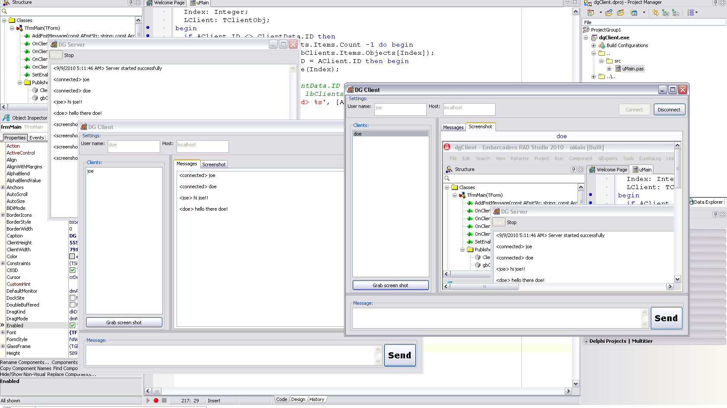
Source: http://www.delphigeist.com/2010/09/custom-client-server-application-with.html

Slide 9
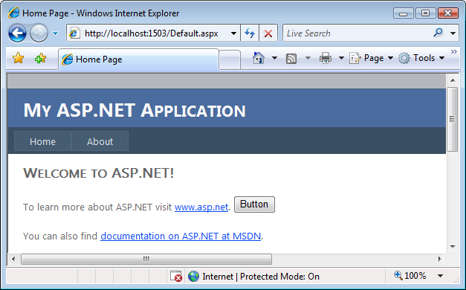
Source: http://dotnetmonitor.vlasovstudio.com/2010/07/06/monitoring-asp-net-applications/

Slide 10


Slide 11
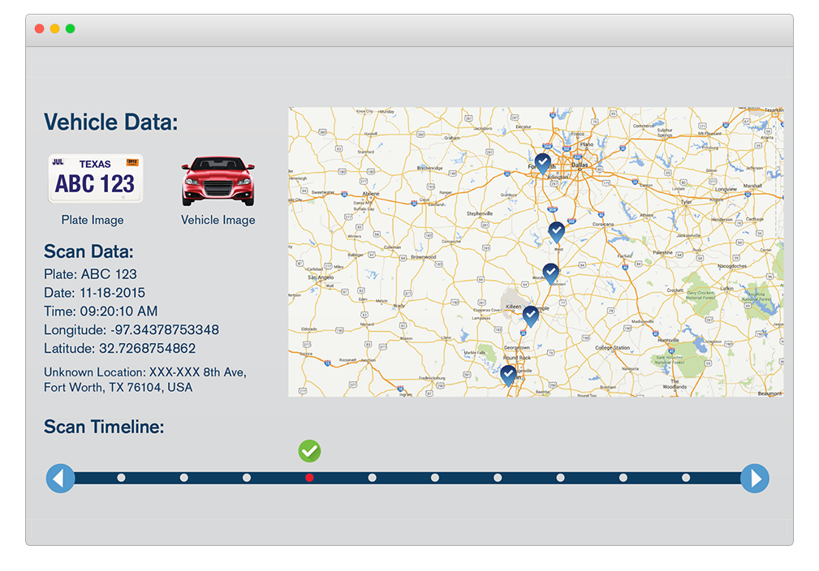
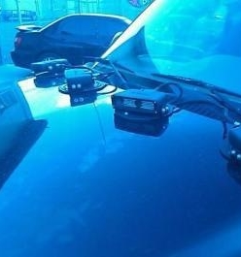

Slide 12


Slide 13

Source: http://cloud9solutions.com/?page_id=19

Slide 14

Source: http://www.passionforsavings.com/weekly-ad/dell-black-friday-ad/9/

Slide 15


Slide 16

Source: https://www.dreamstime.com/royalty-free-stock-photos-cloud-help-text-please-writing-letters-written-clouds-image36840678

Slide 17
What is the cloud?

Slide 18




Slide 19

Source: http://colocation-expert.com/

Slide 20

Source: http://www.businessinsider.com/why-amazon-is-so-hard-to-topple-in-the-cloud-and-where-everybody-else-falls-2015-10

Slide 21
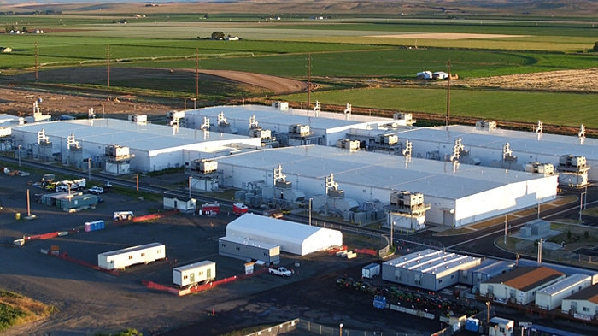
Source: http://images.techhive.com/images/article/2016/12/microsoft-data-center-100697997-large.jpg

Slide 22
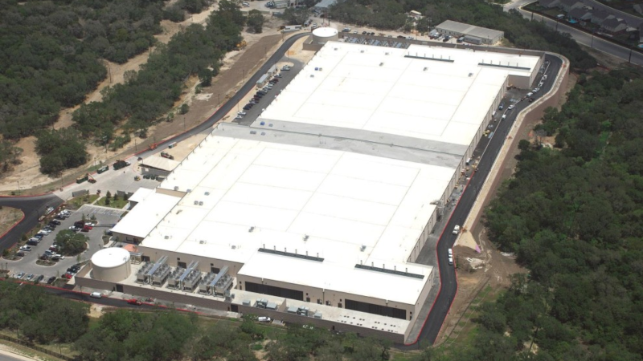

Slide 23
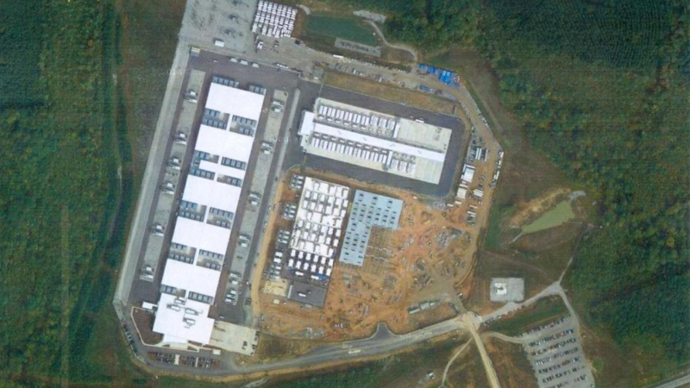

Slide 24
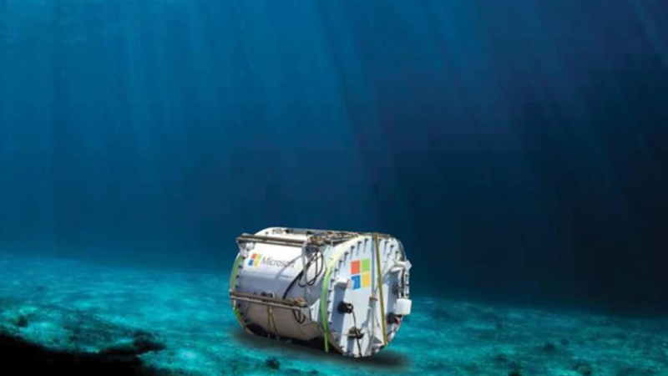

Slide 25
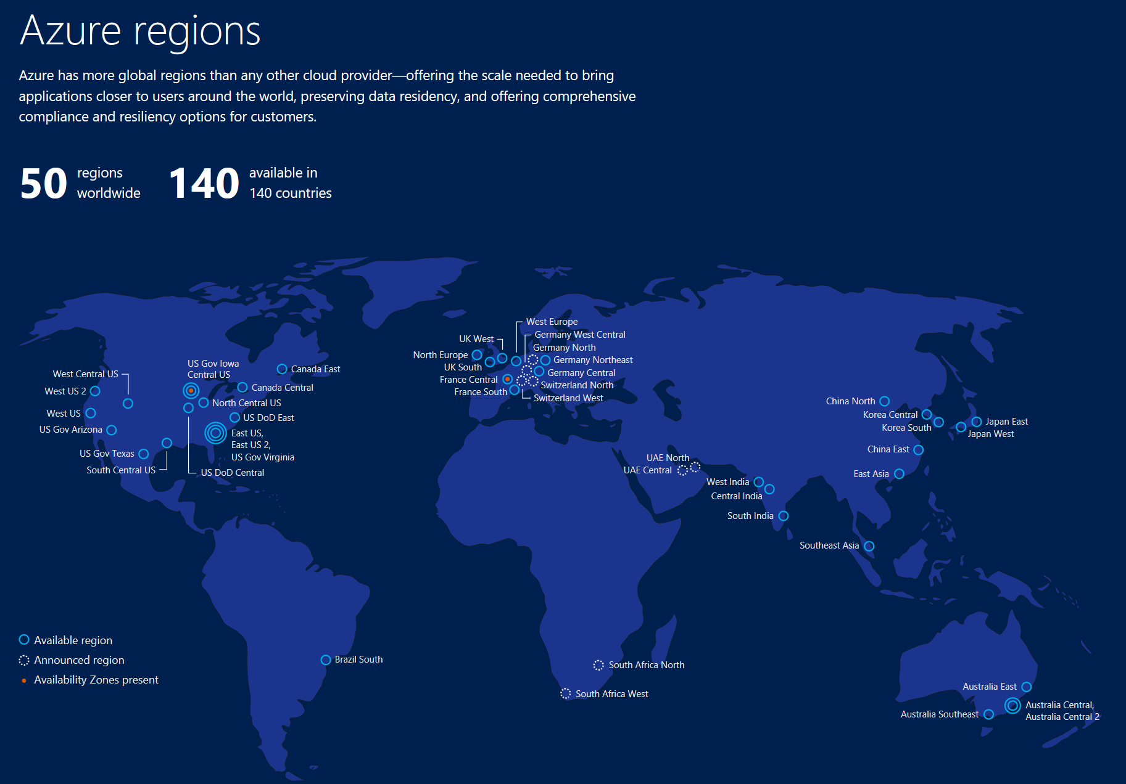

Slide 26
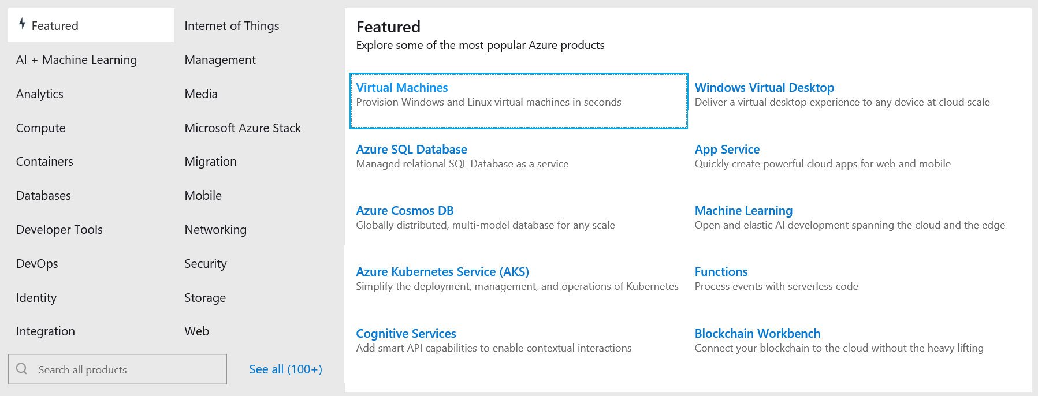
Cloud Services

Slide 27

Why is this important for you?
Source: http://st.depositphotos.com/1491329/1280/i/950/depositphotos_12801547-stock-photo-school-girl-or-student-sitting.jpg

Slide 28

Microsoft Imagine
https://imagine.microsoft.com
Free Software
Build web, mobile, games, mixed reality
Free Cloud
Host a website & database
Free Training
Imagine Cup Competition
Source: http://www.cloudsprawl.net/beware-of-clouds-bearing-gifts-in-todays-iaas-competitive-landscape/

Slide 29

Artificial Intelligence

Slide 30
What is AI?
https://www.youtube.com/watch?v=mJeNghZXtMo

Slide 31

What is Artificial Intelligence
Artificial Intelligence is the theory and development of computer systems able to perform tasks intelligently similar to a human being.
Using known data, develop a model to predict unknown data.
Source: https://www.differencebetween.com/difference-between-machine-learning-and-vs-artificial-intelligence/
https://theaviationist.com/wp-content/uploads/2013/03/Skynet.jpg

Slide 32

What is Machine Learning
Machine Learning is a type of Artificial Intelligence that gives the ability for a computer to learn without being explicitly programmed. It uses an algorithm to parse data, learn from it, and make decisions accordingly.
Source: https://www.differencebetween.com/difference-between-machine-learning-and-vs-artificial-intelligence/
https://cdn.redshift.autodesk.com/2016/05/Machine-Learning-hero.jpg

Slide 33
Machine Learning: Examples from History
1997
2008
2009
2010
2014
2015
Hotmail launches
Which email is junk?
Bing maps launches
What’s the best way to home?
Bing search launches
Which searches are most relevant?
Kinect launches
What does that motion “mean”?
Skype Translator launches
What is that person saying?
Azure Machine Learning GA
What will happen next?

Slide 34
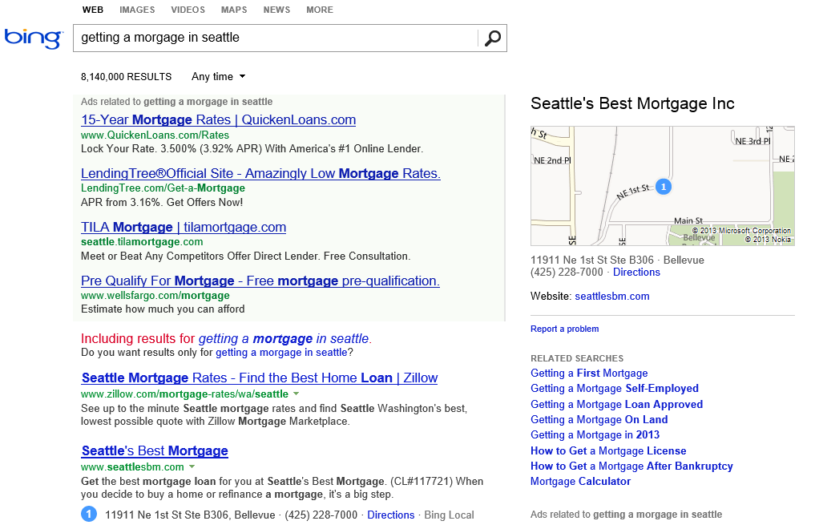
What is the probability of a click on each ad?
What language?
What is the intent?
Which ads to show, and in what order?
Are any of these pages malicious?
Misspelled?
What pages should we index?
What ad pricing will optimize revenue?
Which links are most likely to get clicked?

Slide 35
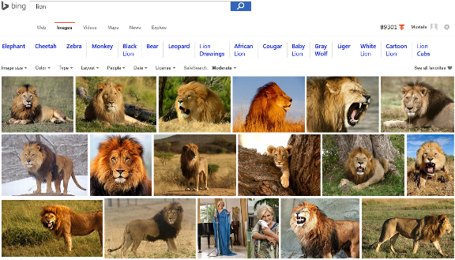
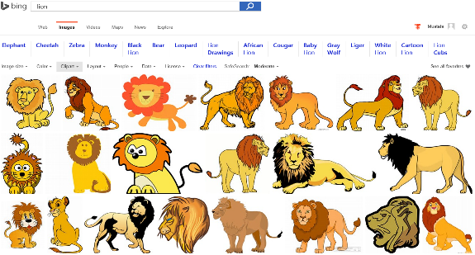
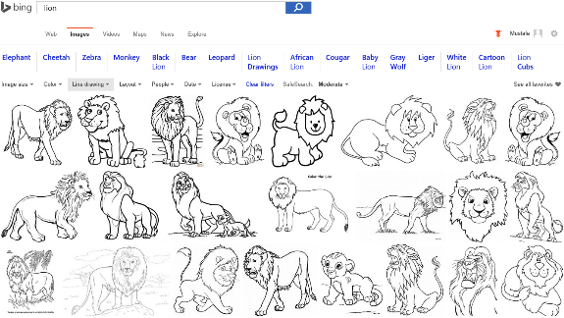
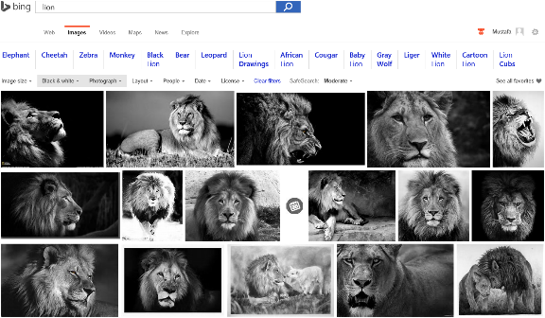
Image Analyze

Slide 36

Accent Color: Which border color is the best?

Slide 37
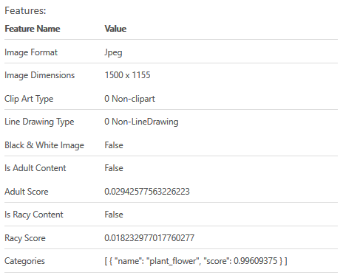

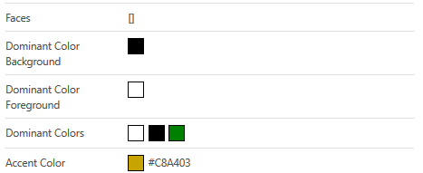
Accent Color: Analyze Image

Slide 38
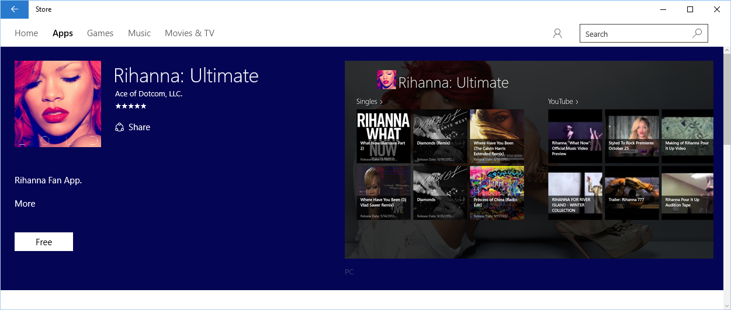
Accent Color: Windows 10 Store

Slide 39
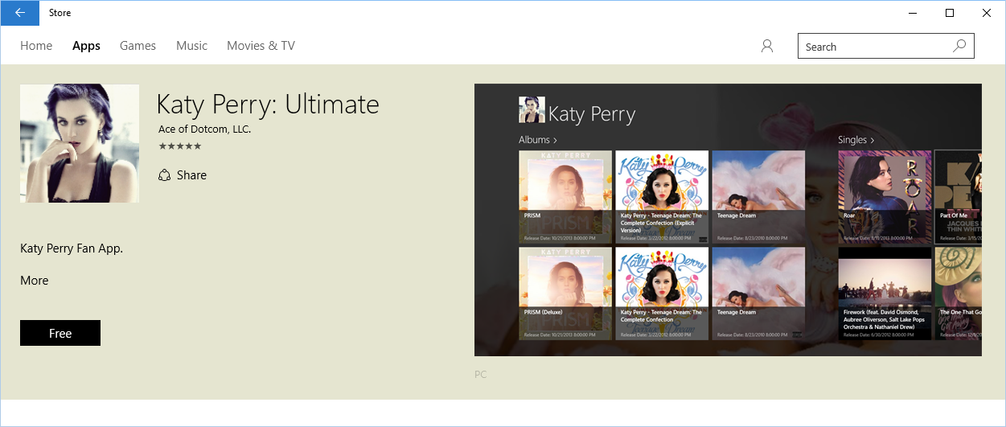
Accent Color: Windows 10 Store

Slide 40
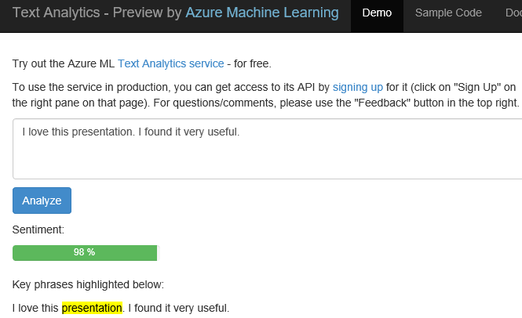
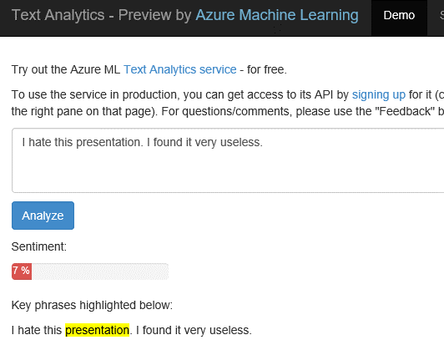
Text Analytics: User reviews
Positive
Negative

Slide 41
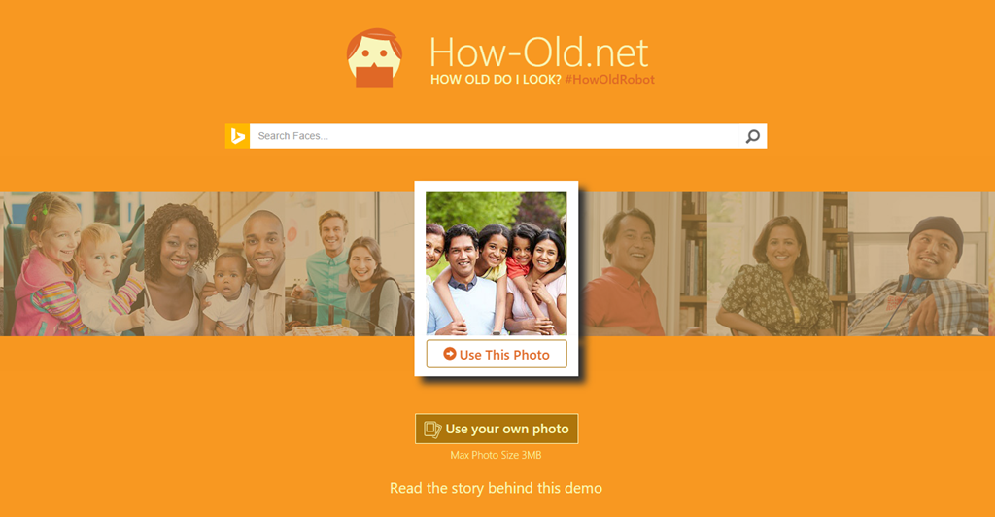
https://how-old.net

Slide 42
https://what-dog.net

Slide 43
Demo: Come Say HI

Slide 44

Using AI to play video games
Video: https://www.youtube.com/watch?v=zQyWMHFjewU
Source: https://mspacmanblog.files.wordpress.com/2014/10/ms_pacman_white.jpg

Slide 45
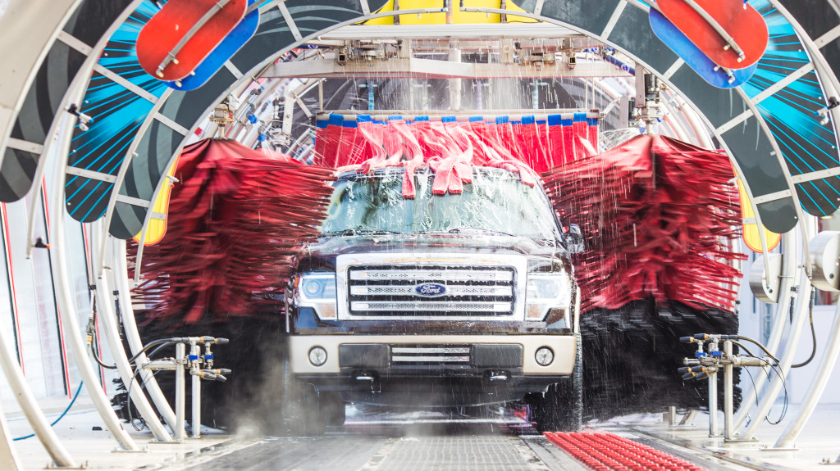

Slide 46
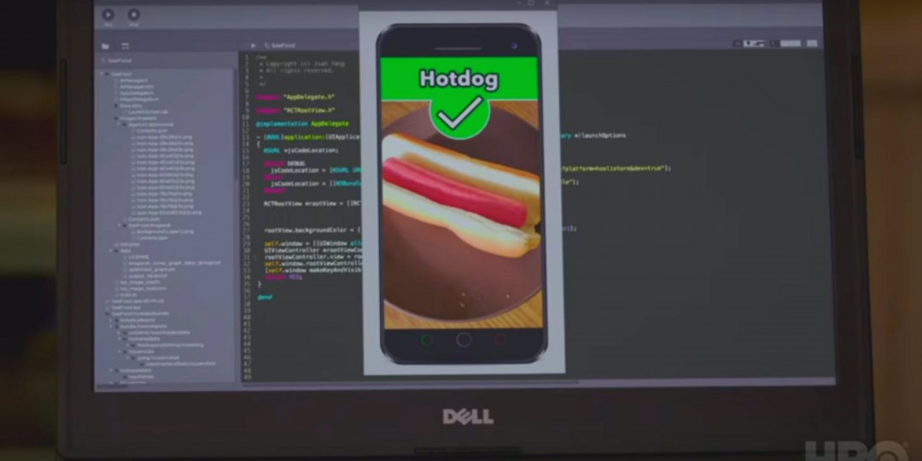
Hot Dog Challenge
https://aka.ms/TEALS/HotDogOrNot

Slide 47
Build it – Choose training images
Download 10 pictures of hot dogs from the internet AND 10 pictures of pizza
Save them to your desktop
You have 10 minutes
HINT: you can use image search to find them https://www.bing.com/images
TIP: make sure each is smaller than 4 MB and is a jpg, png or bmp

Slide 48
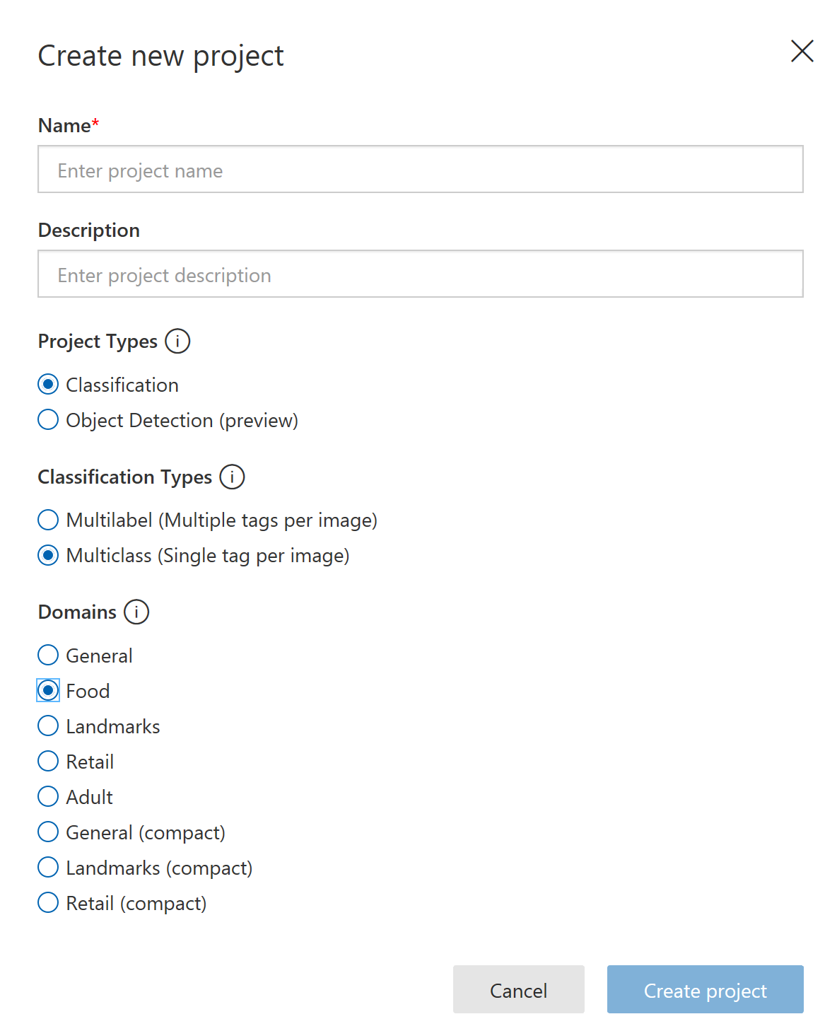
Build it – Create Project
Go to https://customvision.ai
Login with your Microsoft Creds
Give your project a meaningful name and description
Create a new project with the following settings

Slide 49
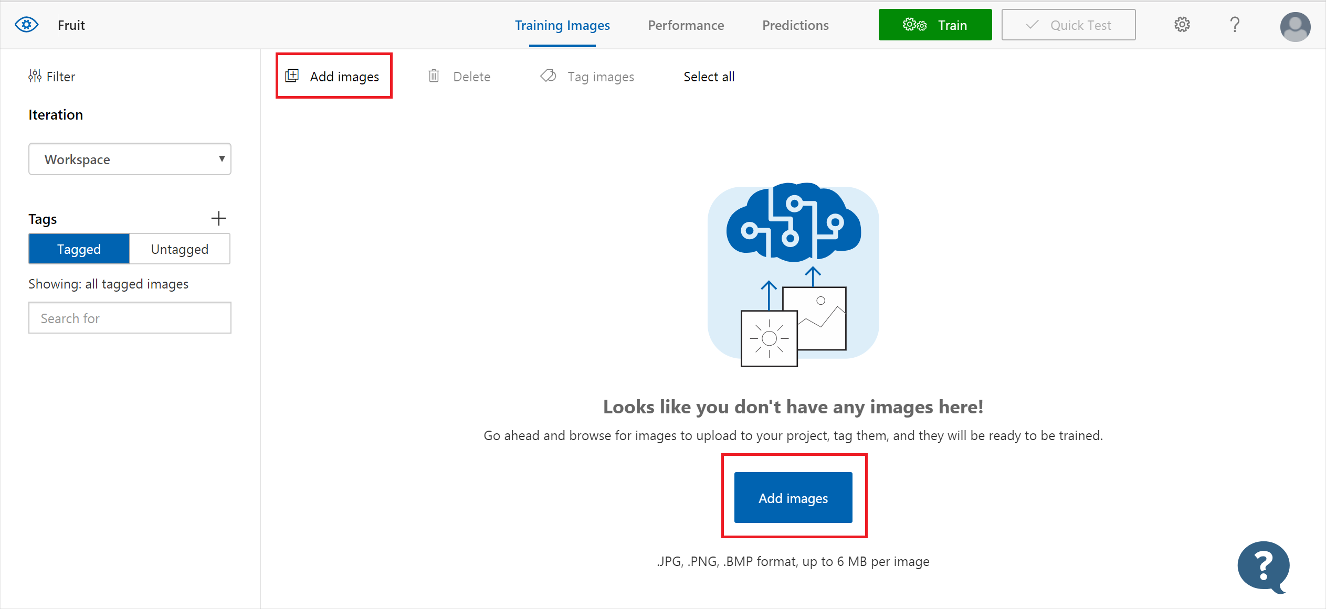
Build it – Upload and tag images
Upload 14 images (7 hot dogs, 7 pizza)
Tag each image as either “hot dog” or “pizza”

Slide 50
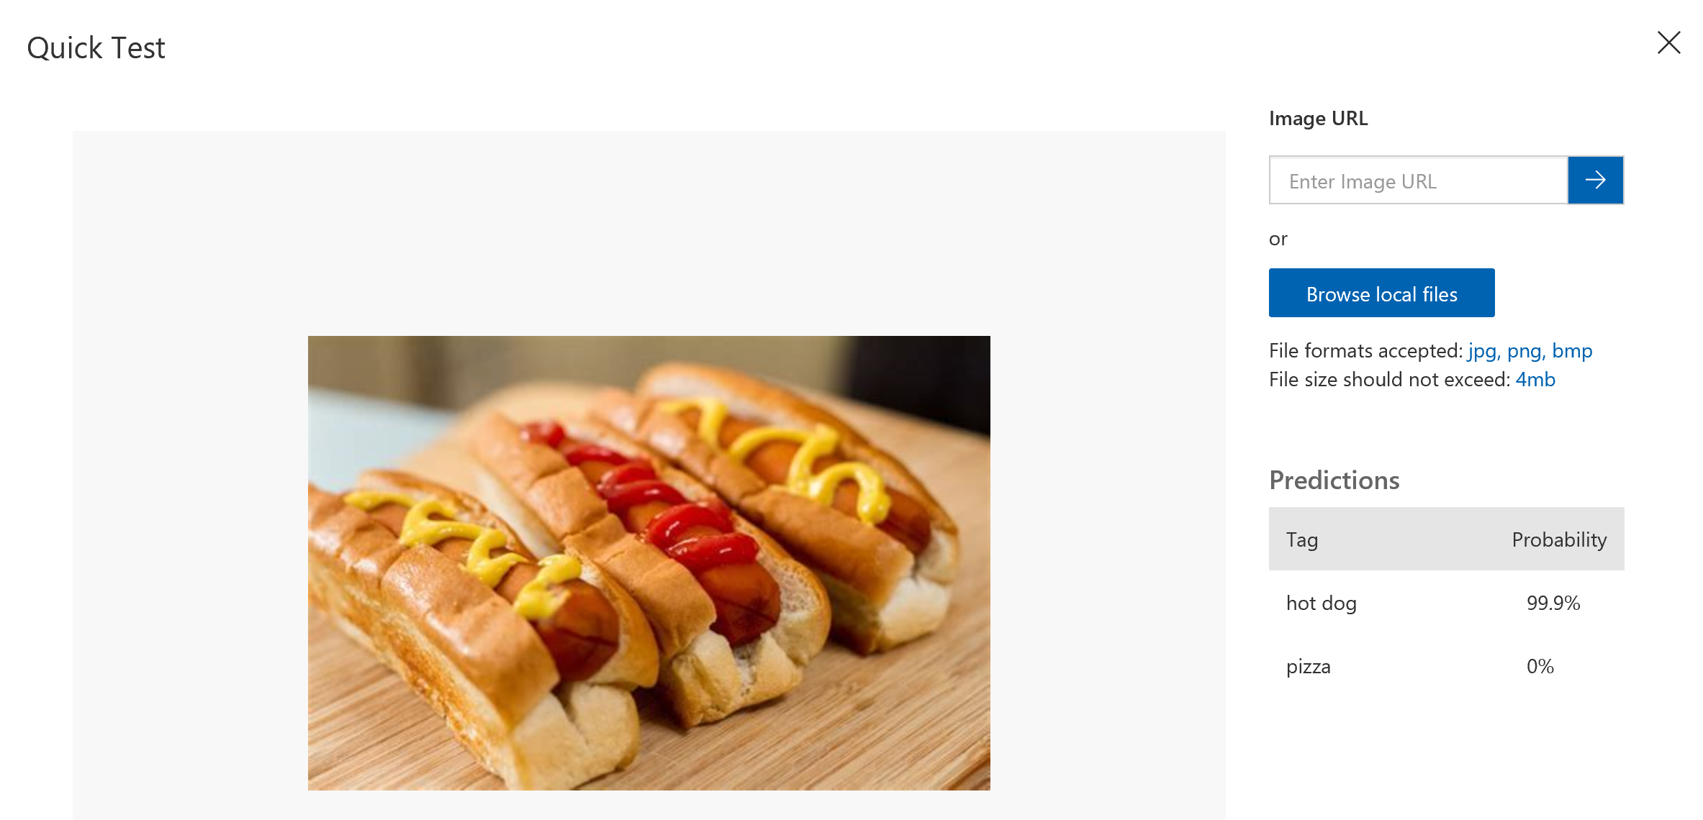
Build it – Train and test your ML Model
Press the green Train button to train the model
Test your model using the “quick test” button and 6 pictures you did not upload

Slide 51
Extend it
Create a new project to do something interesting to you.
Examples:
What character is it? Fortnite, i.e. Apex, Pokémon or your favorite game
What type of sports ball is it? i.e. Baseball, football, golf ball, soccer ball
Brand/Logo detector? i.e. Coke, Pepsi, Dr. Pepper
NOTE: please select something school approperate

Slide 52

Source: http://adjunctassistance.com/teaching-tips-techniques/questions-teaching-tips-techniques/how-college-faculty-should-ask-their-students-questions

Slide 53

Email: sweisfel@microsoft.com
LinkedIn: https://www.linkedin.com/in/shawnweisfeld/
Download Slides @ https://aka.ms/WHS/20190305

